Slide 1
Template Method Design Pattern
The template method design pattern falls under the category of behavioral design pattern.
The Template Method pattern provides an outline of a series of steps for an algorithm.
Objects that implement these steps retain the original structure of the algorithm but have the option to redefine or adjust certain steps.
This pattern is designed to offer extensibility to the client developer.
@ShankaragoudaG

Slide 2
Template Method Pattern
Template means Preset format like HTML templates which has a fixed preset format. Similarly in the template method pattern, we have a preset structure method called template method which consists of steps.
These steps can be an abstract method that will be implemented by its subclasses.
This design pattern is used popularly in framework development. This helps to avoid code duplication also.

Slide 3
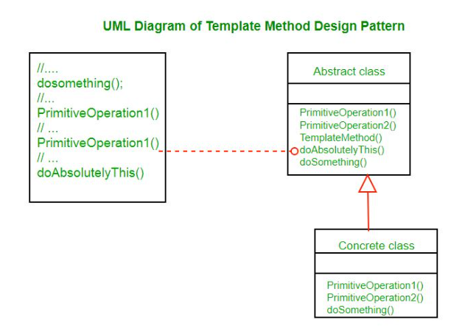
UML Diagram

Slide 4
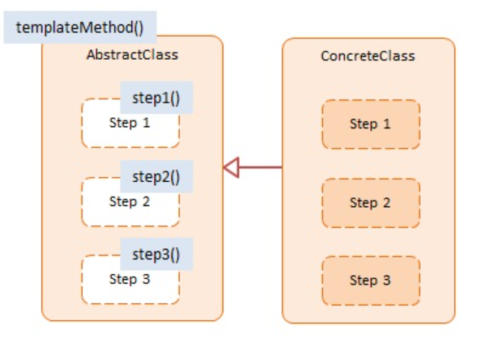
Diagram
AbstractClass:
offers an interface for clients to invoke the templateMethod
implements template method which defines the primitive Steps for an algorithm
provides the hooks (through method overriding) for a client developer to implement the Steps
ConcreteClass:
implements the primitive Steps as defined in AbstractClass

Slide 5
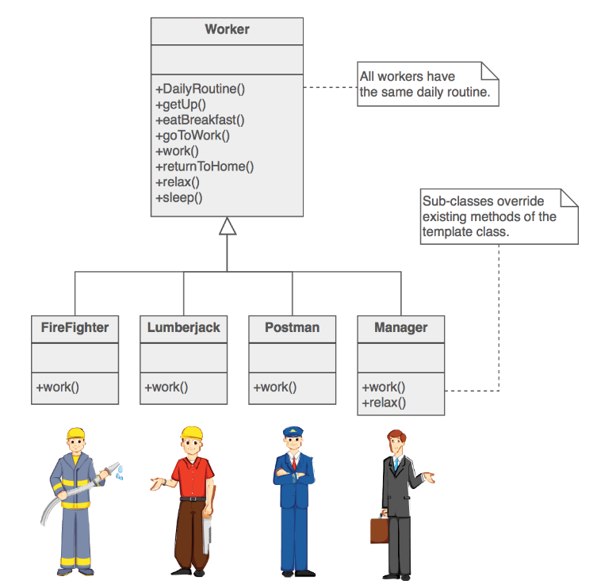
Example

Slide 6
Example
This is an example where we use JavaScript's prototypal inheritance. The inherit function helps us establish the inheritance relationship by assigning a base object to the prototype of a newly created descendant object.
The datastore function represents the AbstractClass and mySql represents the ConcreteClass. mySql overrides the 3 template methods: connect, select, and disconnect with datastore-specific implementations.

Slide 7
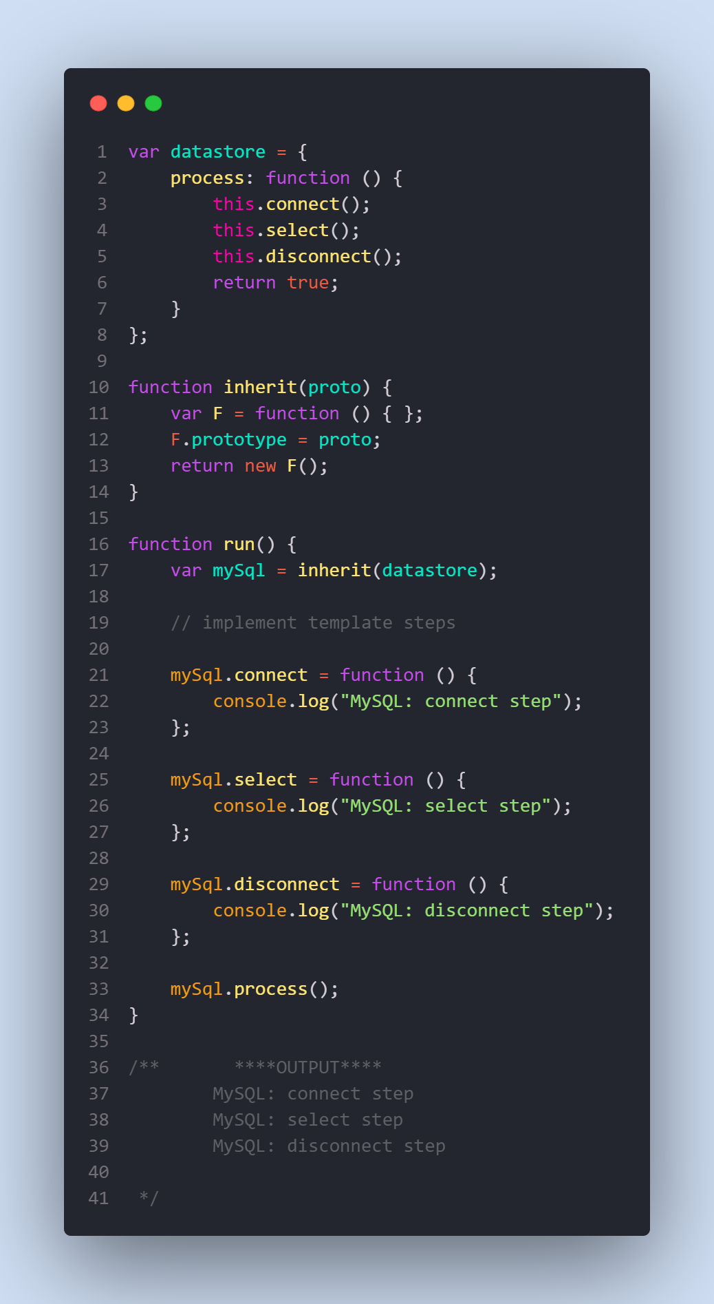

Slide 8
Useful Resources
https://www.dofactory.com/javascript/design-patterns/template-method
https://sourcemaking.com/design_patterns/template_method
https://www.scaler.com/topics/template-method-design-pattern/
https://www.geeksforgeeks.org/template-method-design-pattern/

